Slide 1

[Infosys Springboard 5.0] NAME: Aryan Katiyar ROLE : AI/ML INTERN EMAIL: 2k22.cse.2213298@gmail.com MENTOR: Anurag Sista
TumorTrace: MRI-Based AI for Breast Cancer Detection

Slide 2
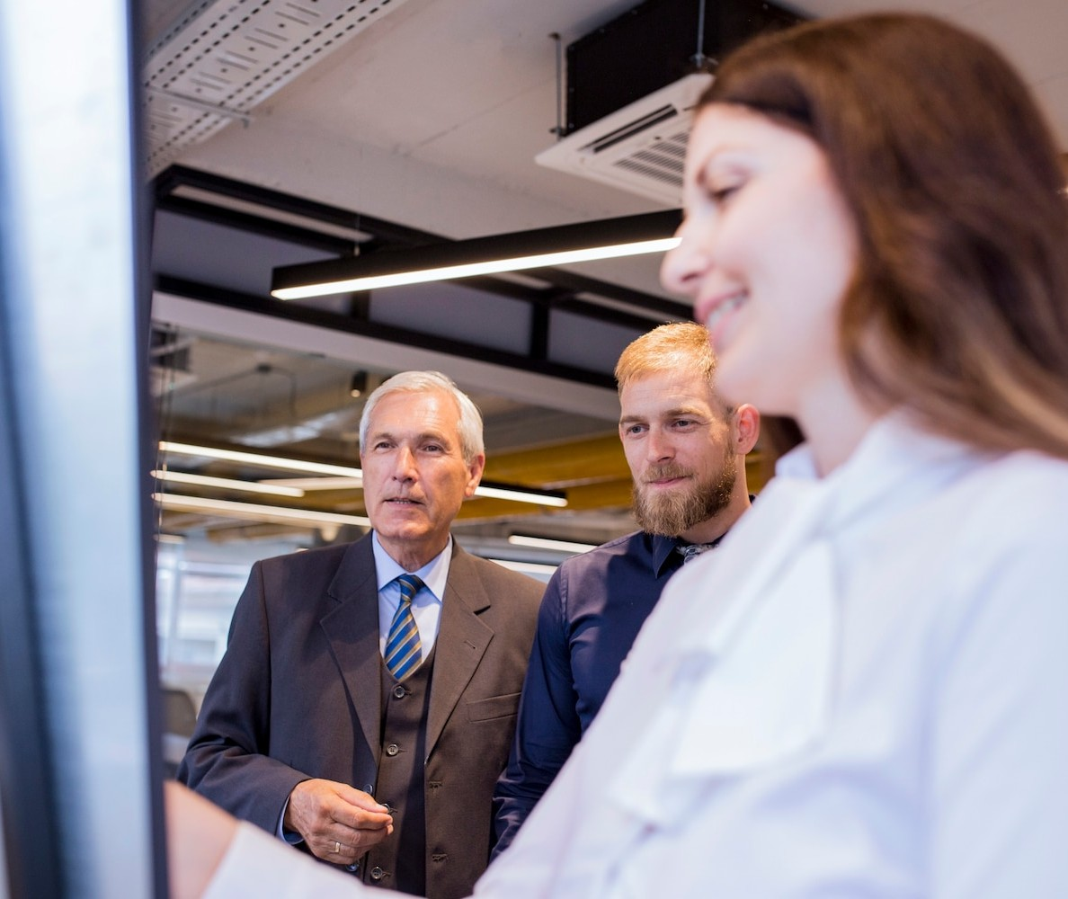
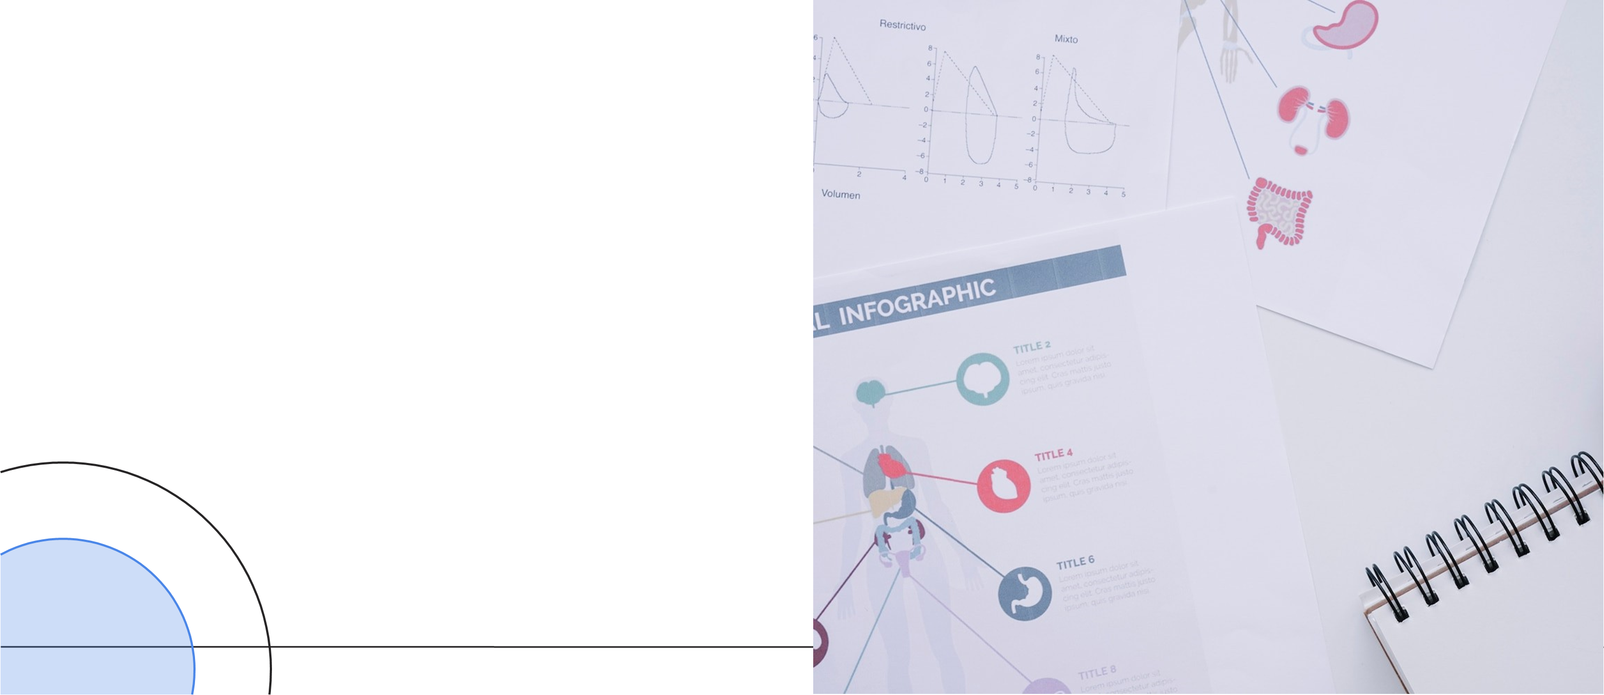
PROBLEM STATEMENT
Breast cancer is a leading cause of death among women globally, emphasizing the critical need for early detection to improve survival rates. A key challenge lies in accurately classifying breast tumors as benign (non-cancerous) or malignant (cancerous), which is vital for determining appropriate treatment.
To address these challenges and enable earlier predictions, we developed several AI models, including VGG16, ResNet18, and ResNet50, which leverage MRI scans to classify tumors as benign or malignant with high accuracy. These models aim to enhance diagnostic accuracy, reduce time, and assist radiologists in providing timely and reliable predictions.

Slide 3
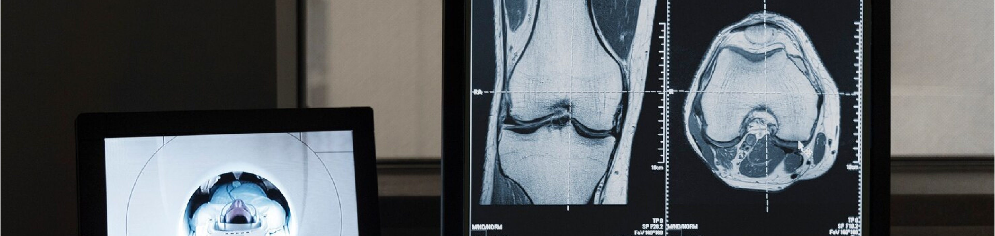
DATA COLLECTION
The dataset used for this project consists of MRI breast cancer images, labeled into Benign and Malignant categories. The dataset is sourced from ScienceDirect and is utilized to train and evaluate the machine learning models in this project.
2. Structure
Total Number of Images:
Training Set: 20,434 images
Validation Set: 1,989 images
Testing Set: 6,851 images
Labels:
Benign: Non-cancerous tumors
Malignant: Cancerous tumors
Dataset Split:
The dataset is divided into the following proportions:
70% Training: Used to train the model and allow it to learn the characteristics of both benign and malignant tumors.
10% Validation: Used to tune the model and validate its performance during training.
20% Testing: Used for final model evaluation to assess its generalization ability on unseen data.
This dataset structure ensures that there is enough data for both training and evaluation, providing a reliable basis for model development and testing.

Slide 4

Data Preprocessing
All images were resized to 224 x 224 pixels, matching the required input size for the models.
The pixel values, originally ranging from 0 to 255, were scaled down to a range of 0 to 1 by dividing by 255.

Slide 5
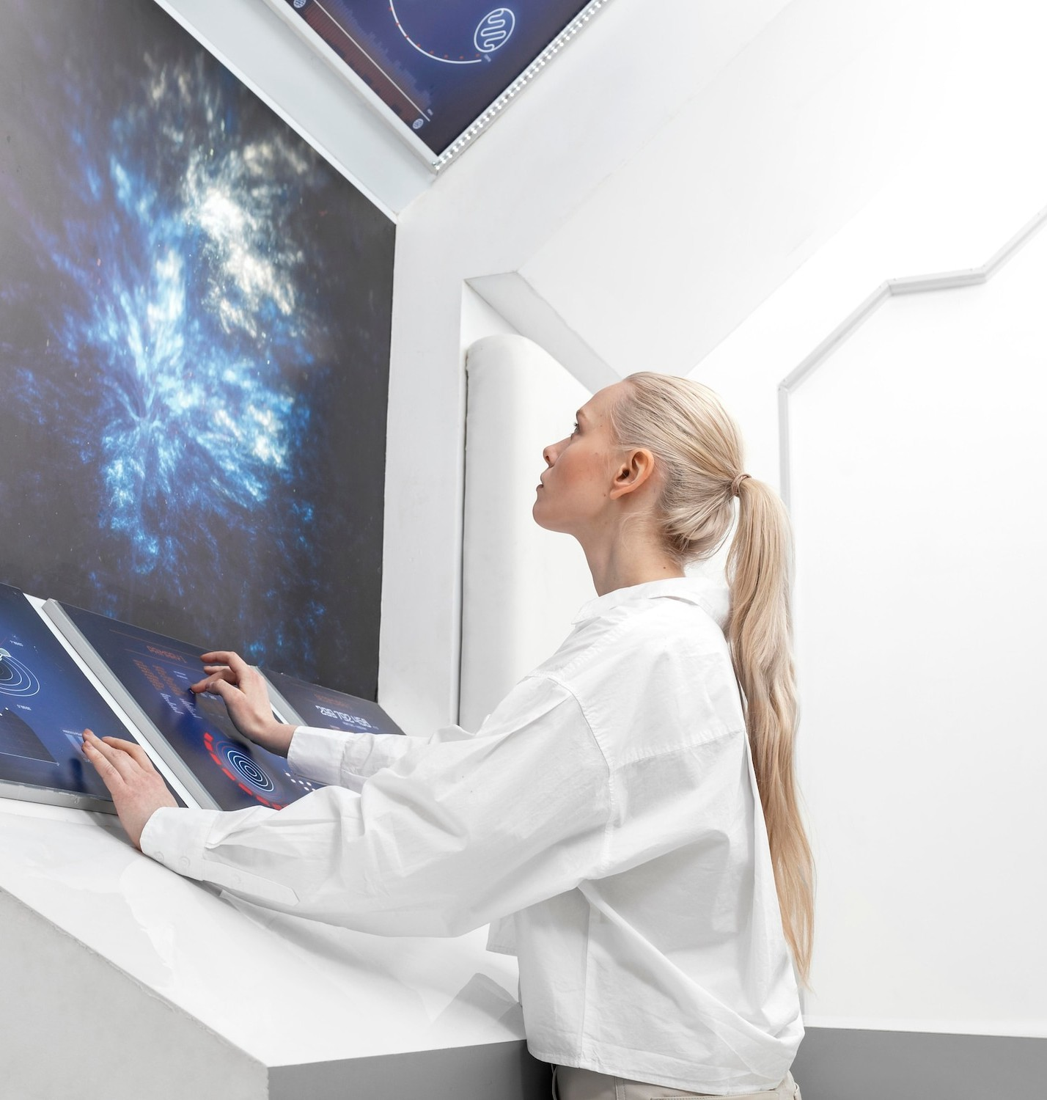
MODELS
VGG16 Custom Model: While VGG16 is known for its simplicity and reliability, it may not perform as well as ResNet architectures on more complex datasets. Its shallow depth limits its ability to capture intricate patterns compared to deeper models like ResNet.
ResNet18: Offers a balanced trade-off between performance and computational efficiency. It is particularly well-suited for systems with limited hardware (e.g., without GPUs), providing good results with lower computational cost.
ResNet50: Outperforms VGG16 and ResNet18 in terms of feature extraction due to its deeper architecture. It is ideal for datasets with complex patterns but demands higher computational resources. If computational power is available, ResNet50 provides the best results for the task of breast cancer classification.

Slide 6
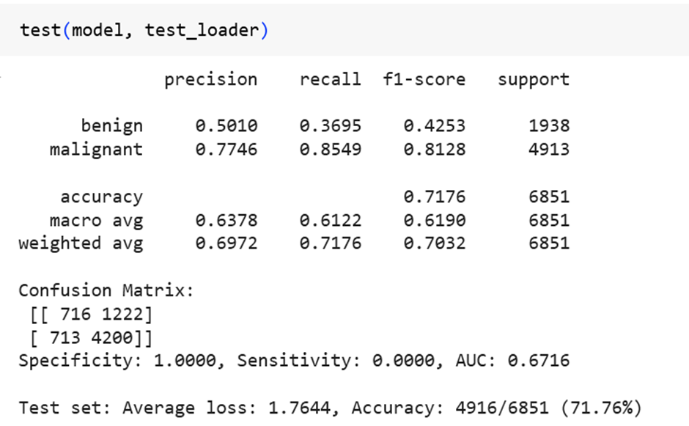
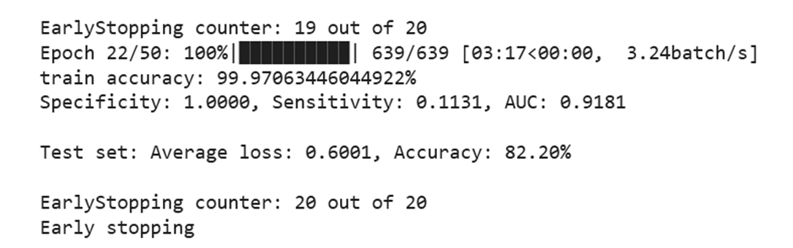
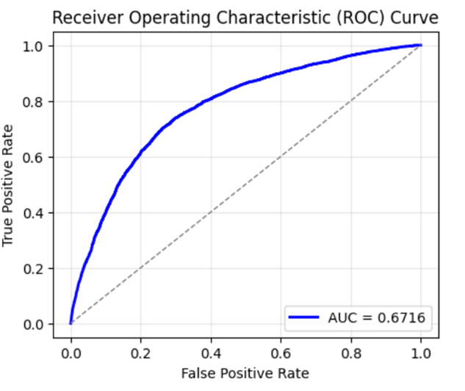
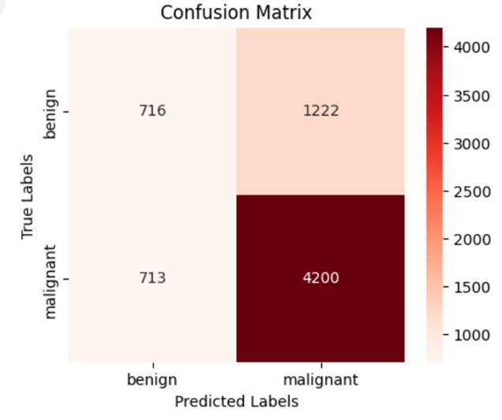
RESULTS 1. VGG16

Slide 7
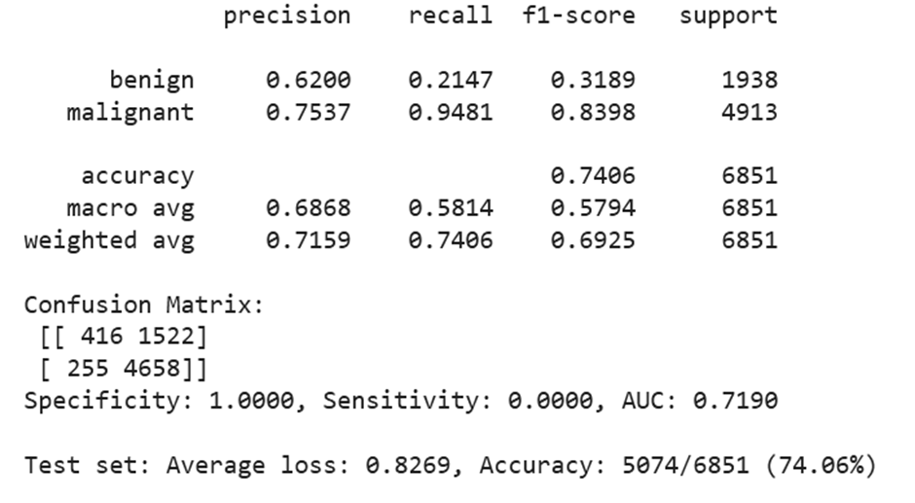
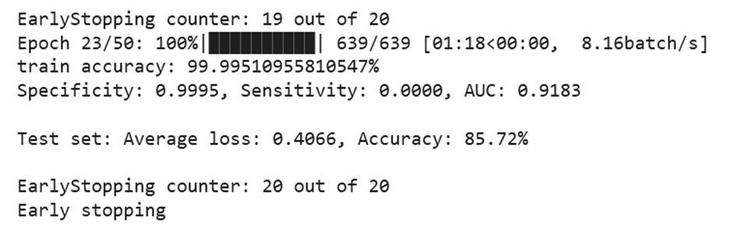
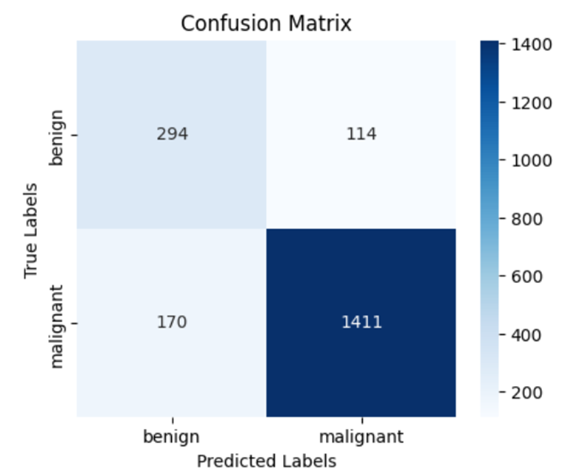
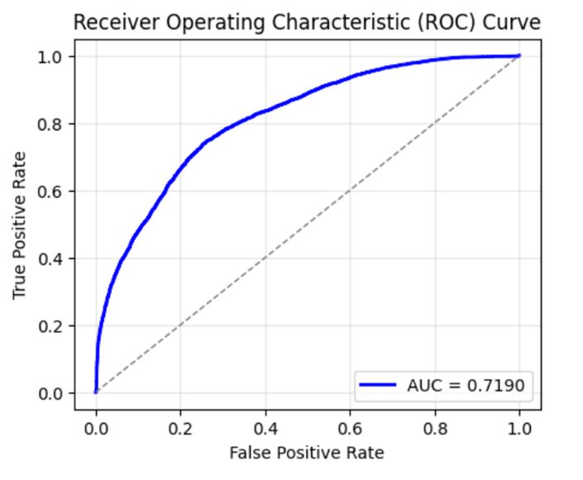
RESULTS 2. RESNET18

Slide 8
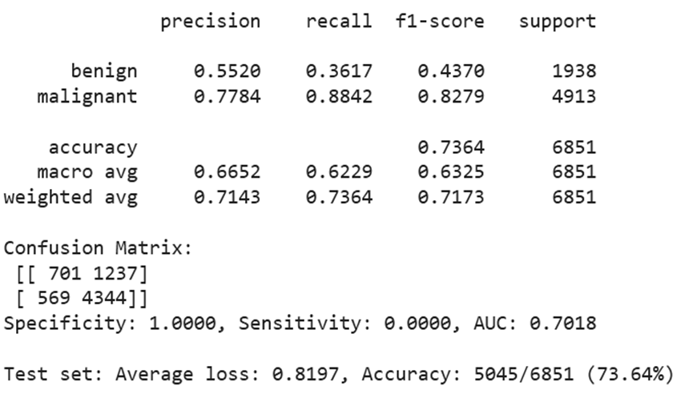
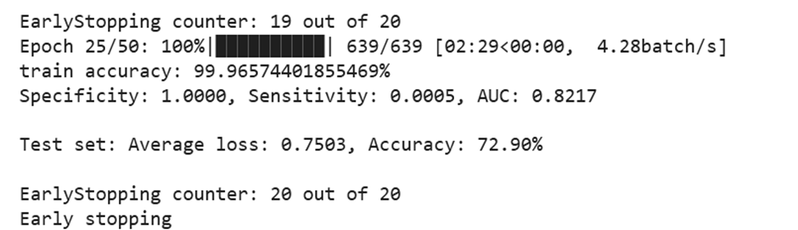
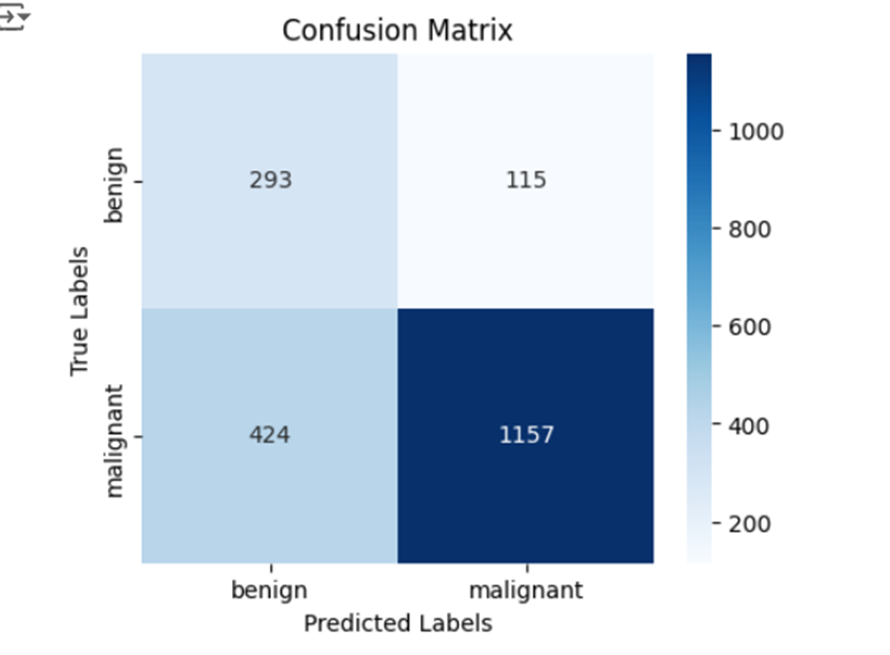
RESULTS 3. RESNET50

Slide 9
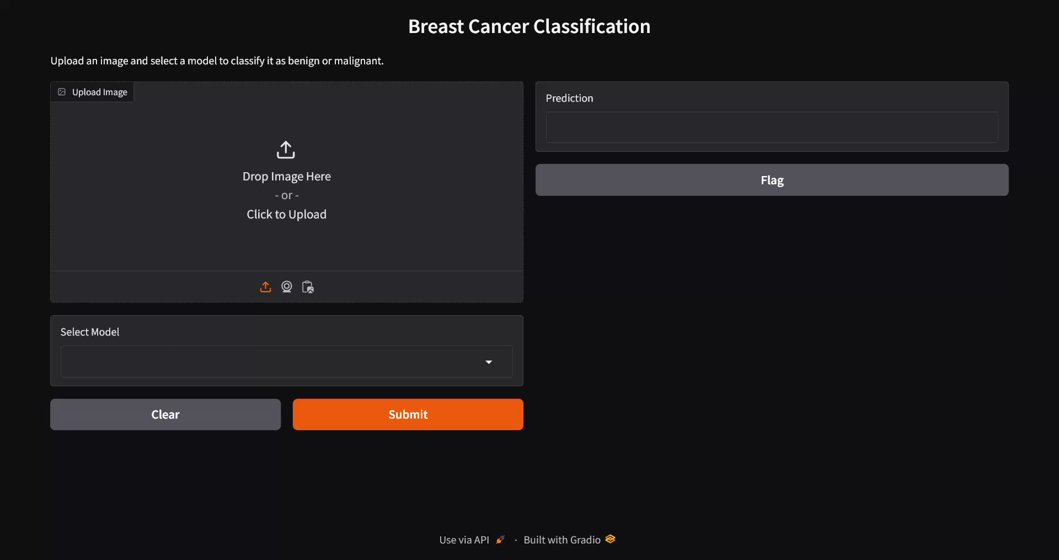
OUTPUT:

Slide 10
Thank You !!

